Slide 1
West Niagara Minor Hockey Association
In House and Local League Town Hall
February 28, 2023

Slide 2
Agenda
Meeting rules
Overview of top 10 Responses
Future state of programing
Open Floor for Questions
Closing Items

Slide 3
Meeting Rules
Respect the person speaking
Keep all comments and feedback professional
Please wait until we open the floor for questions

Slide 4
Top Ten Responses
Cost of Hockey / Budget
Community based teams or blended teams
Where we play, local loop or Niagara district
Do we continue to play Jordan
Quality of house league teams / balancing
Quality of coaching and Practices
Full and Half ice practices
Scheduling
Tournaments
Communication

Slide 5
Cost of Hockey Budget Items
Items used to calculate Fees
Ice costs
Referee costs
Insurance and Fees
Uniforms and equipment
Administration and operating costs
Team Sizes
Registration numbers
Additional income

Slide 6
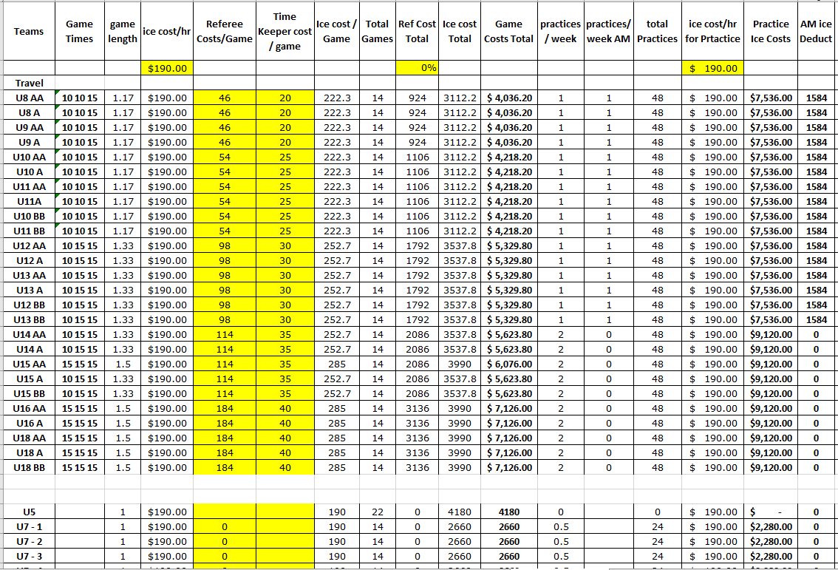
Cost of Hockey Budget Items
Player cost models

Slide 7
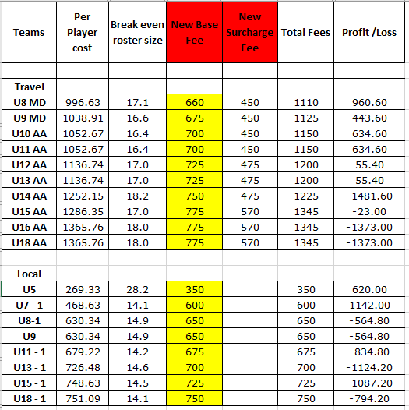
Cost of Hockey Budget Items
Player cost models

Slide 8
Cost of Hockey Budget Items
Summary
Typically younger age groups break even or show some positive funds
Number of players on team have large affect positive or negative
Older age groups this season had large increase in Referee costs
Uniforms and equipment cost increased by 40%
Ice cost are also going to increase

Slide 9
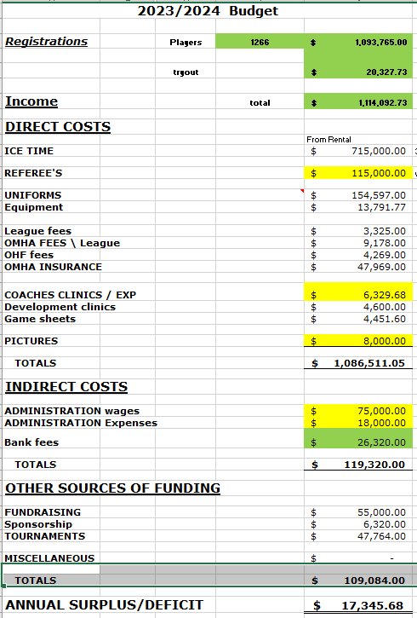
Cost of Hockey Association Budget

Slide 10
Community based teams or blended teams
The Association is currently operating under the following mandate as stated in our Constitution
MISSION OF THE ASSOCIATION
3.1 The purpose of the Association is to organize, develop and promote minor ice hockey for the youth of West Niagara Minor Hockey Association and those territories granted to the Association by the OMHA. To provide the opportunity to participate at the highest competitive level; To instill in all players, coaches, managers, and members associated with the West Niagara Minor Hockey Association, good sportsmanship, correct and proper behavior on and off the ice, respect for authority and team play.
3.2 The Association shall be carried on and operated as a not-for-profit corporation without the purpose of gain, for its Members, Directors or Officers and any profits or other accretions to the Association shall be used in promoting its objects.
3.3 In accordance with the Ratification vote completed March 2022, Lincoln Minor Hockey, West Lincoln Minor Hockey and Grimsby Minor Hockey have agreed to surrender their existing OMHA rights to Representative Teams, and to transfer such rights to the Association, which shall operate, manage, and administer a Representative Team hockey program on behalf of the Parties and the Local League Members.
3.4 In accordance with the Ratification vote completed March 2022 Lincoln Minor Hockey, West Lincoln Minor Hockey and Grimsby Minor Hockey have agreed to surrender their existing rights to run recreational Local League programs and to transfer such rights to the Association. The Association will continue to manage and offer community specific teams playing out of their hometown arenas and local communities.

Slide 11
Community based teams or blended teams
Current Process
Members are able to select preferred rink base on availability
Teams are constructed and balanced based on arenas selected
Players maybe asked to move to alternate Arena
Moves are requested to accommodate goalie requirements
Moves also requested due to team numbers / registration wait lists
Future Process
As an association we are always looking for solutions to issues
Discussions have been ongoing to what is the best process for team composition / balancing
Any changes are required to be presented and voted on at the yearly AGM

Slide 12
Where we play, local loop or Niagara district
Currently the association has tried to maintain inhouse programing for all age groups
This current season due to numbers our U8 Local League teams participated in the Niagara District Loop
We have received feedback both positive and negative in regards to traveling outside of our association for game play
Key items to consider when playing in Niagara district loop
No control over game times or schedules
No control over team competitiveness
Does offer variety of teams to play
Key items to consider for in house play
Better control over schedules
Ability to have fixed days of the week
Less travel expense for families

Slide 13
Do we continue to play Jordan
For Clarification Jordan Minor Hockey is a separate Hockey Association
We worked with them over the past several season to offer a larger Varity of teams to play against
Based on feedback provided we will not continue the relationship with Jordan next season
West Niagara is projecting to have the following teams in local league next season base on all players returning
U7 5 Teams
U8 6 Teams
U9 5 Teams
U11 8 Teams
U13 8 Teams
U15 7 Teams
U18 7 Teams
Based on the numbers above it is the proposal of the board to remain playing in house for all age groups.
If any of the age groups U11 to U18 drop below 6 teams we would look to move them into the Niagara district loop.
U7 to U9 would move to Niagara district if we drop below 4 teams

Slide 14
Quality of house league teams / balancing
Under current setup we can only balance teams at each rink
Representative teams will not be folded unless the number of players drops below the limits required to form a team.
U15 teams next season will return to regular practices and game counts
U18 will Start the season with weekly practices and phase them out over the coarse of the season to add additional games

Slide 15
Quality of coaching and Practices
Please remember all coaches are volunteers
In almost all age groups this year we have new coaches to the program that have never coached before.
The development committee is working on multiple items for next year to assist coaches and team staff in the operation of the team
Coaches hand book
Team expectations / guidelines
Practice plans

Slide 16
Full and Half ice practices
As indicated in the prior budget item the registration cost for local league players is based on shared practices
Current guidelines used allow for one age below or one age above to share ice.
Ideal team numbers per rink would be even number of teams but due to accommodating max number of players per local rink this is typically gets altered
Rep teams pay additional fees and costs related to having full ice practices
Rep teams U14 and below are also required to use 6:30 am practice times
All additional ice times has cost implications

Slide 17
Scheduling
If we proceed with in house programing as suggested with no outside teams we have the ability to set a full season schedule
If you play in the Niagara district this is scheduled by the league
If you play with Jordan you have to accommodate what ice times they have
If we don’t have enough officials at a specific rink games get moved
The association acknowledges that the area of scheduling can be improved but it will never be perfect due to all the moving parts
Our Goal is to offer all teams what they are entitled to and manage the costs at the same time

Slide 18
Tournaments
The current rep tournaments that are offered provide a significant amount of income to the association as indicated prior.
This income subsidizes all players in the association.
We are open to running recreations team tournaments
Please note some areas of concern
If we mandate that all teams participate in tournament same as rep we have limited space for outside teams
If we don’t offer opportunity to all teams how do we pick who can play
In past local league teams preferred going to away tournaments
Tournaments would have to take place over Christmas, March Break and Family day.
Additional volunteers would be required to organize and operate the tournaments

Slide 19
Communication
Communication is an area that can always be improved.
Based on the feedback provided we are investigating the following
Adding a dedicated board position specific to communication and documentation
Additional information added to our website
Monthly news letters and meeting summaries

Slide 20
Future State of Programing
U5, U7, U8
Offered at 3 rinks based on Registration numbers
Volunteers required for next season to fill vacancies
U8MD, U9MD
Will not exist next season due to Hockey Canada changes in programing
Offerings of Tiered structure and additional development groups to be added
U11, U13, U15, U18
Offered at 3 rinks based on Registration numbers
All programing to be inhouse based on numbers

Slide 21
Open Floor

Slide 22
Closing Remarks

